Slide 1
Employee Data Analysis using Excel
STUDENT NAME:E.SARANYA
REGISTER NO:312204205
Nm ID:ID388DF89349F2DA938408BF
DEPARTMENT:B.COM(GENERAL)
COLLEGE:C.S.I EWART WOMEN’S CHRISTIAN COLLEGE.

Slide 2
PROJECT TITLE
Employee Performance Analysis using Excel

Slide 3


AGENDA
Problem Statement
Project Overview
End Users
Our Solution and Proposition
Dataset Description
Modelling Approach
Results and Discussion
Conclusion
3/21/2024 Annual Review

Slide 4

PROBLEM STATEMENT
Basic Excel functions may not fully support advanced performance analysis.
Need for complex formulas or additional tools for in-depth analysis.

Slide 5

PROJECT OVERVIEW
Implement charts and graphs to visualize performance trends.
.

Slide 6

WHO ARE THE END USERS?
HR professionals
Employees
Managers and supervisors
Talent development manager
IT Sector
Different Organisations

Slide 7

OUR SOLUTION AND ITS VALUE PROPOSITION
Conditional Formatting – Missing
Filter- Remove
Formula – performance
Pivot-Summary
Graph- Data visualization

Slide 8
Dataset Description
Employee Dataset- kaggle
26 features
Features -9 Features
Employee ID
Gender –Male,female
Performance
Business Unit
First Name
Last Name
Employee rating
Employee timing –Full time or contract

Slide 9

THE "WOW" IN OUR SOLUTION
Performance level formula
=IFS(Z2>=5,“Very high”,Z2>=4,“High”,Z2>=3,“MED”,True,“Low”)
3/21/2024 Annual Review
9

Slide 10
MODELLING
Visilization
Formulas
Data collection
A performance evaluation Model is crucial for a company as it measures individual and collective employee
It’s helps to Identify the strength and areas to improvement and contributes to goals and continuous improvement
10

Slide 11
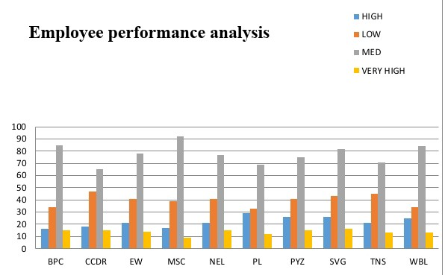
RESULTS
11

Slide 12
conclusion
The conclusion section of an employee performance analysis using Excel should summarize the key insights, evaluate the effectiveness of the analysis, and provide a clear path forward.

